Slide 1

Horizontal Pod Scalling Chuli jimmi Manurung https://github.com/chulijimmi https://www.linkedin.com/in/chulijimmi/
Docker & Kubernetes
FUNDAMENTAL

Slide 2
Technology Evolution
Server
Virtual Machine
Container System

Slide 3


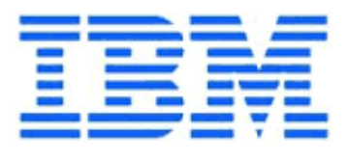
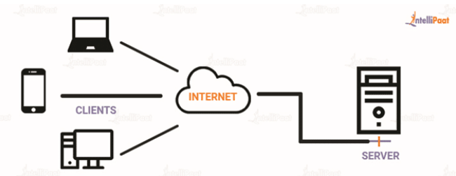
Server
In computing, a server is a piece of computer hardware or software (computer program) that provides functionality for other programs or devices, called "clients".
Source: Wikipedia

Slide 4
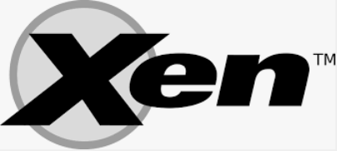
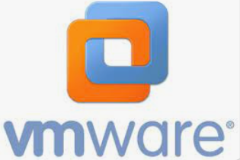
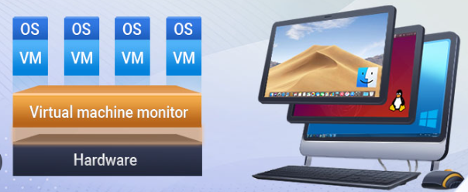

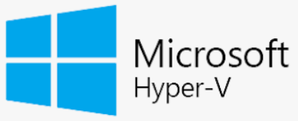
Virtual Machine
In computing, a virtual machine (VM) is the virtualization/emulation of a computer system. Virtual machines are based on computer architectures and provide functionality of a physical computer
Source: Wikipedia

Slide 5
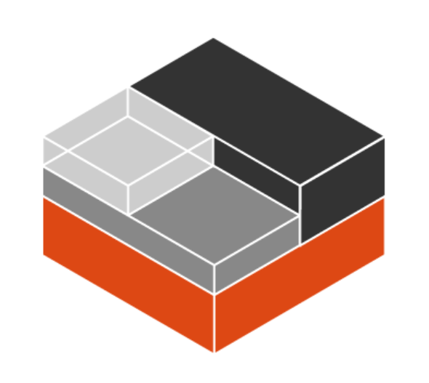
System Containers vs Application containers
Application containers (as provided by, for example, Docker or Kubernetes) package a single process or application. System containers, on the other hand, simulate a full operating system and let you run multiple processes at the same time.
Therefore, application containers are suitable to provide separate components, while system containers provide a full solution of libraries, applications, databases and so on. In addition, you can use system containers to create different user spaces and isolate all processes belonging to each user space, which is not what application containers are intended for.
Source: https://linuxcontainers.org/lxd/introduction/

Slide 6
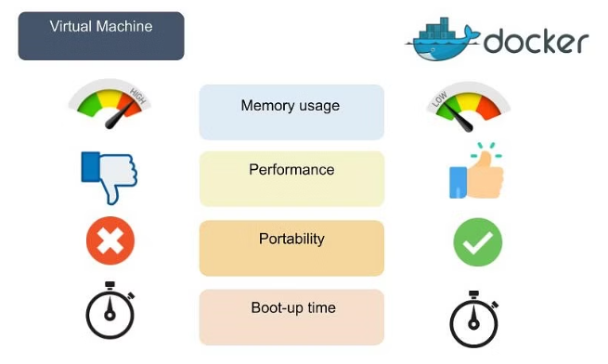
Pro & Cons Container
Container Application
Pros
Iteration speed Robust ecosystem
Cons
Shared host exploits
Source: Simple Learn

Slide 7
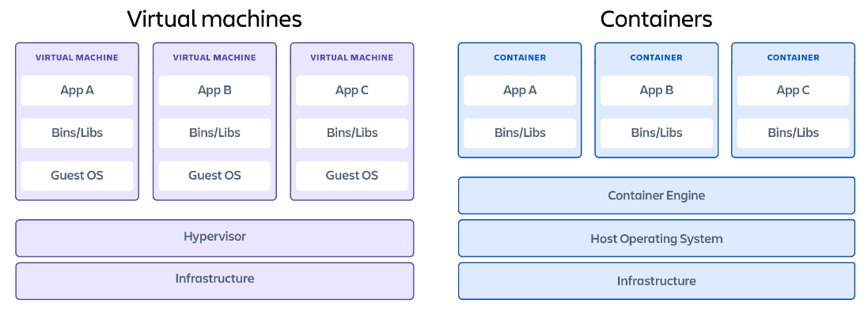
Docker
Release 20 March 2013 Dot Cloud Company
As Container Run Time
The Open Container Initiative (https://opencontainers.org/) Joined in 2015
Source: Atlassian web

Slide 8
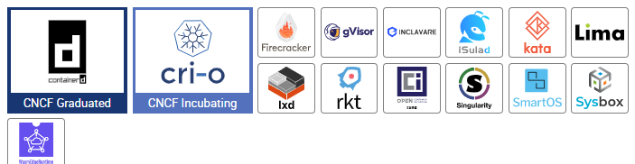
What is container runtime?
A container runtime, also known as container engine, is a software component that can run containers on a host operating system.
Low-Level Container Runtimes
ContainerD
High-Level Container Runtimes
Docker, CRI-O,
Sandboxed and Virtualized Container Runtimes
Sandboxed runtimes don’t share kernel
Provide increased host isolation by running the containerized process in a virtual machine (through a VM interface) rather than a host kernel
Source: aquasec.com

Slide 9
Docker Components
Docker Engine
Docker Images
Docker Registry (Docker Hub)
Docker Volume
Docker Container
Docker Compose
Docker Desktop
Docker Swarm
Source: spiceworks.com

Slide 10
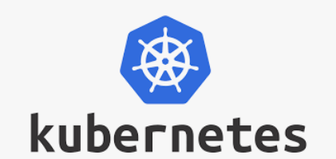
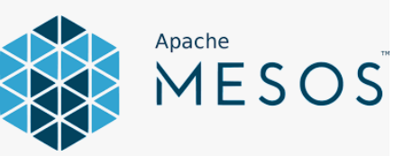
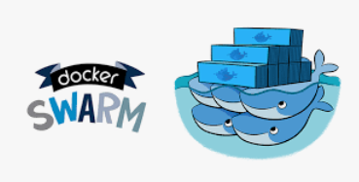
Orchestration
Orchestration is the automated configuration, management, and coordination of computer systems, applications, and services. Orchestration helps IT to more easily manage complex tasks and workflows.
Source: RedHat

Slide 11
Kubernetes
Kubernetes, also known as K8s, is an open-source system for automating deployment, scaling, and management of containerized applications.
Planet Scale
Never Outgrow
Run K8s Anywhere
Source: https://kubernetes.io/

Slide 12
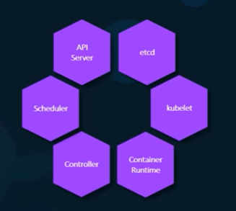
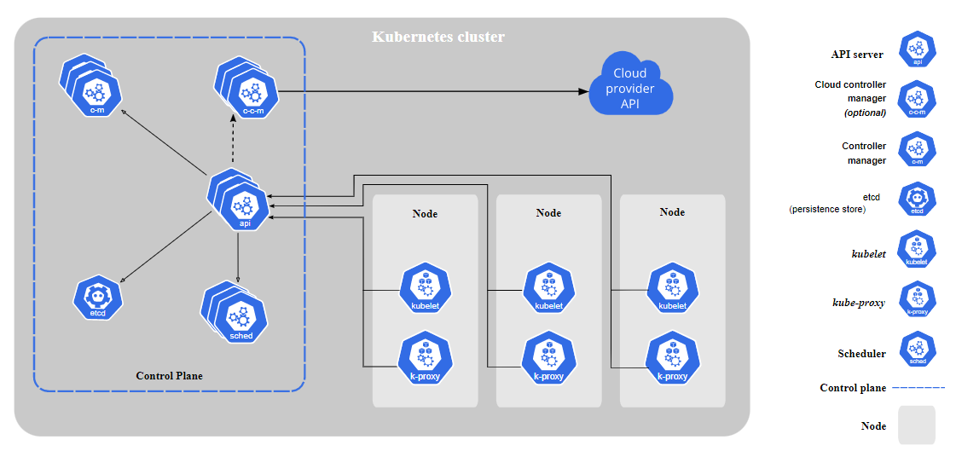
Kubernetes Components
Understanding Kubernetes Components
Youtube.com

Slide 13
Horizontal Pod Autoscaling
As known as HPA
In Kubernetes, a HorizontalPodAutoscaler automatically updates a workload resource (such as a Deployment or StatefulSet), with the aim of automatically scaling the workload to match demand.
Source: Kubernetes.io

Slide 14
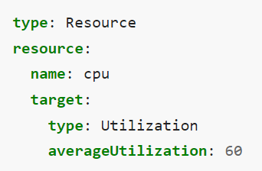
HPA Parameters
Support for resource metrics
CPU
Memory
Source: Kubernetes.io

Slide 15
Demonstration
Pre Requirements
Install Docker DESKTOP
INSTALL OCTANT
JMETER

Slide 16
Conclusion
Technology evolution
Container Application
System Orchestration
Scale app in Kubernetes

Slide 17

Thank You

